Slide 1
LOTO / Hazardous Energy Safety
April 24, 2020
By Team Safesite

Slide 2
LOTO Safety
LOTO (lockout/tagout or lock-tag-try) is the physical restraint of all hazardous energy sources that supply power to a piece of equipment, machinery or system.

Slide 3
The Dangers of Hazardous Energy
According to OSHA, approximately 50,000 injuries and 120 deaths each year are attributed to the failure to control energy in the workplace.
Injuries from hazardous energy include electrocution, burns, crushes, cuts, lacerations, amputations, fractures, etc.

Slide 4
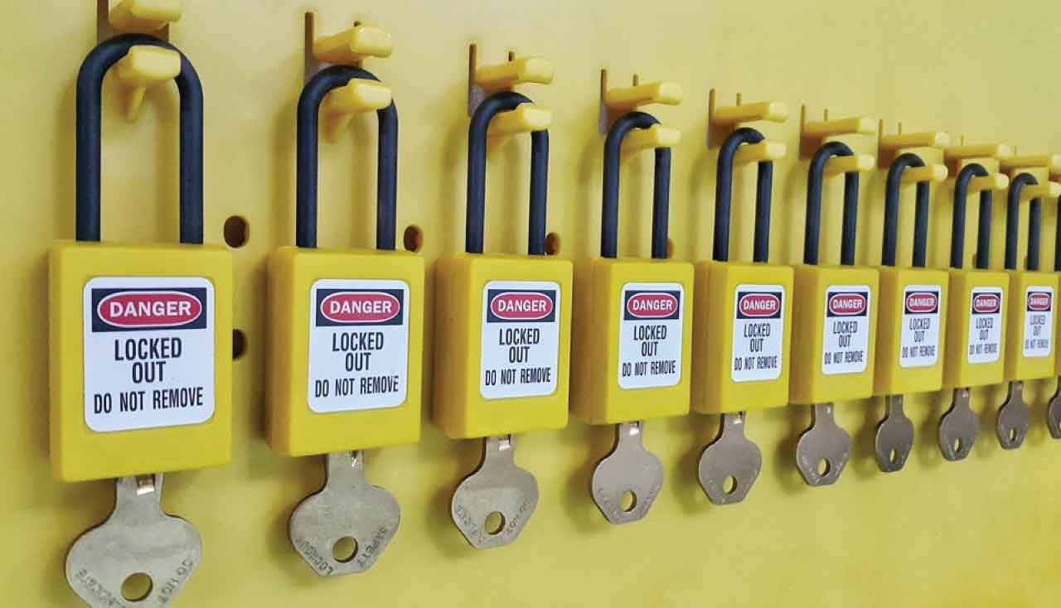
The Purpose of Our Lockout/Tagout Program
The purpose is to protect you and your coworkers by preventing a machine from suddenly starting, or energy accidentally being released while a machine or equipment is being serviced.

Slide 5
Questions for Discussion
What sources of hazardous energy do we use here?
Electrical, Mechanical, Stored energy, Hydraulic, Pneumatic, Heat, Moving Parts, and Springs are all sources of energy.
What incidents or near misses involving hazardous energy have you heard of or experienced?

Slide 6
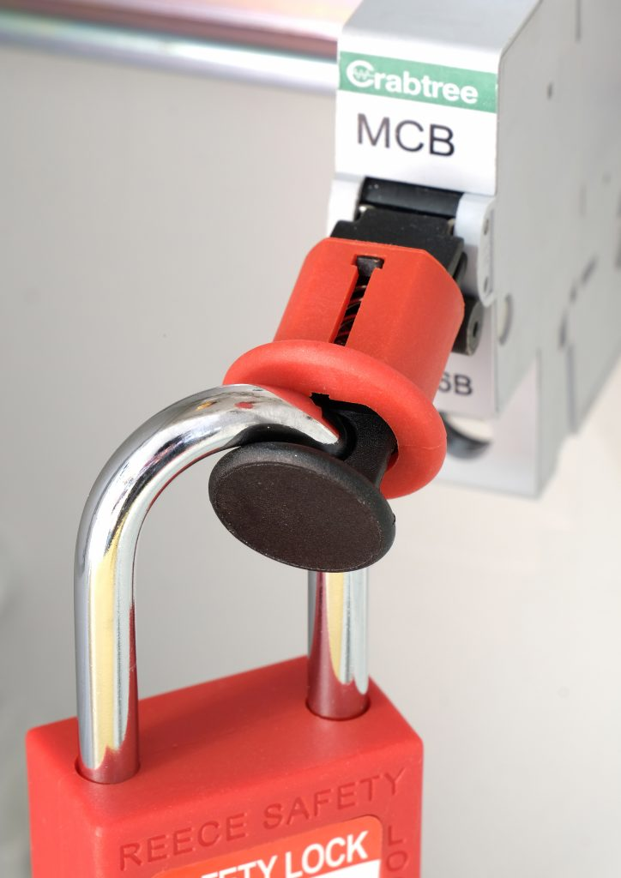
Who Are You?
Affected Employee - An affected employee is any employee who operates or uses the equipment that is under lockout, or who works in an area where lockout/tagout is being performed.
Authorized employee - An Authorized employee is any employee, such as an electrician, who is trained to use LOTO, and who may perform installation, repair or maintenance on equipment.
All employees must know the dangers of hazardous energy safety and not to interfere with a safe LOTO process in any way

Slide 7
Objective of Lockout Procedures
The main objective of the lockout procedures is to achieve a zero-energy state on any piece of equipment being serviced.

Slide 8
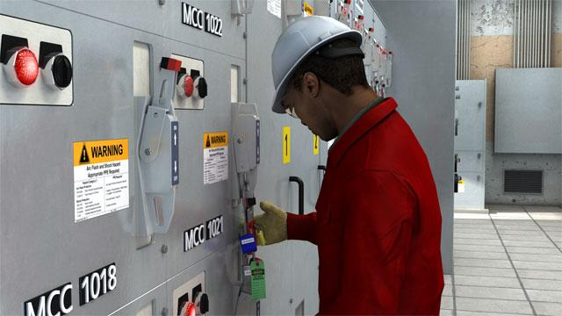
LOTO Procedure for Authorized Employees
Identify the system that you will be working on and the correct procedure for that system.
Think about exactly what you will be doing, where you will be, and what. parts you will be working on or near.
Inform co-workers and other trades in the area that you will be working on the system.

Slide 9
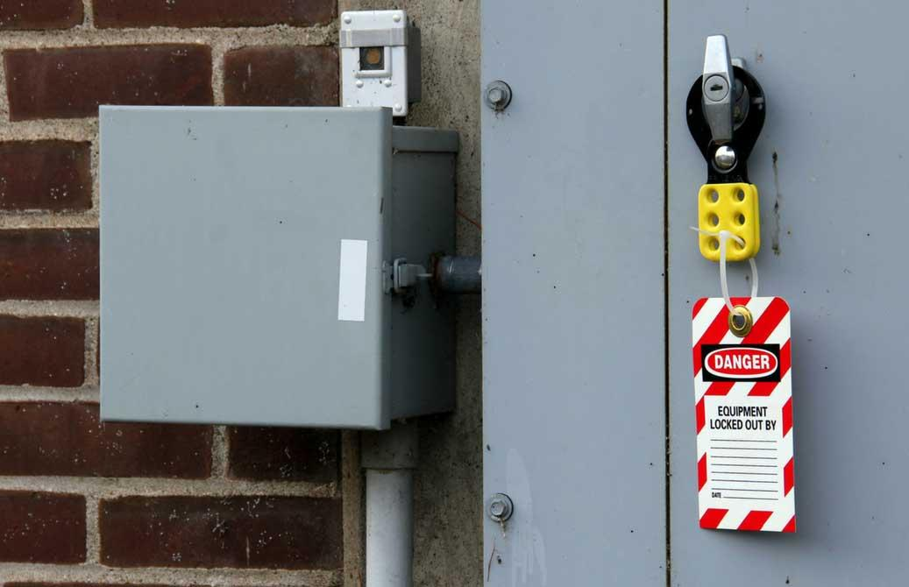
LOTO Procedure for Authorized Employees
4. Be sure you have a lock with only one key, and a tag with your name and phone number on it.
5. Find out if the system if backfed. If it is—even if it's a low-voltage backfeed—you will have to disconnect the backfeed circuit in order to fulfill LOTO procedures.
6. Understand the energy: type, amount, hazards, and control methods. Will you open a breaker, remove a fuse, shut off a valve, or insert a plate?

Slide 10
LOTO Procedure for Authorized Employees
Follow procedures to shut down the equipment
Disconnect electrical power.
Disconnect or block and vent pneumatic and hydraulic sources
Release stored pressure.
Guard hot surfaces.
Follow every step in the lockout procedure down to the last detail.
Don't take shortcuts.
Once you are ready and you know the system is clear, lock it out at each energy source.
Apply your lock or lockout device.
Each person working in the area must install his or her personal lock.
Try all controls to make sure the equipment does not start.
Check and double-check that everything is off downstream.

Slide 11
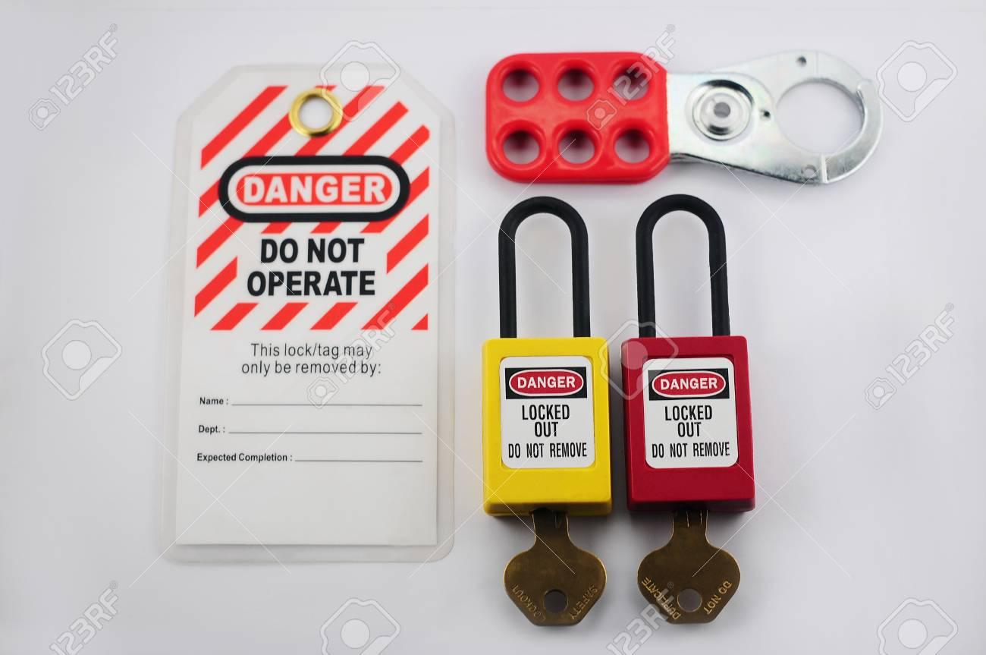
LOTO Procedure for Authorized Employees
When you're finished, remove your tools and clean up the area. Make sure your co-workers and other trades are out of the danger zone.
Notify everyone that you are going to re-energize the equipment only when you are confident that
1} all workers and tools are accounted for, and 2} it is safe to put the system back into service.

Slide 12
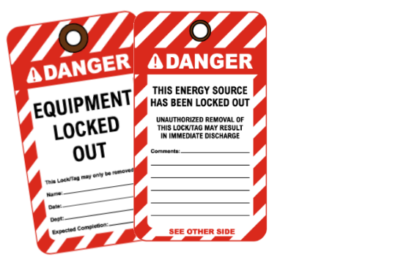
LOTO Procedure for Authorized Employees
Remove your locks, but never remove anyone else's locks or tags.
Carefully re-energize and restart the equipment or have the appropriate operators restart it.

Slide 13
LOTO for Affected Employees
Know the correct LOTO Procedures but don’t ever lock out or remove locks from any machines, even if asked by an authorized employee.
Assist authorized employees, as requested, to ensure proper shutdown and identification of isolation locations

Slide 14
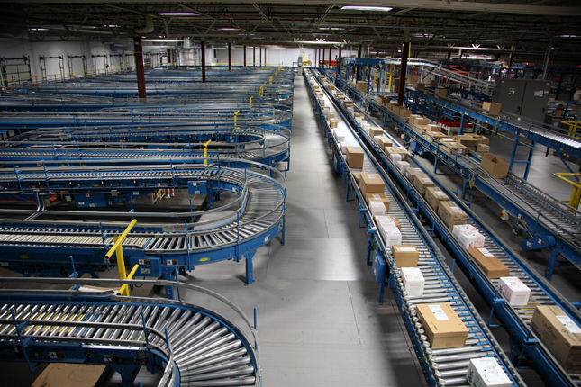
LOTO for Affected Employees
Don’t attempt to start equipment/machines that are locked or tagged out, until notified by the authorized employee that machines are ready for use.
Don’t work or clean on or around powered down or locked out equipment without permission from authorized employee. Authorized employees must notify you to leave the area before unlocking a machine.

Slide 15
Questions for Discussion
How can you tell if a machine or piece of equipment has been locked out vs. only powered off?
What are some examples of faulty assumptions or shortcuts that would violate a safe LOTO process?
What is the most important piece of equipment in LOTO?
Where are the danger zones around our equipment?

Slide 16
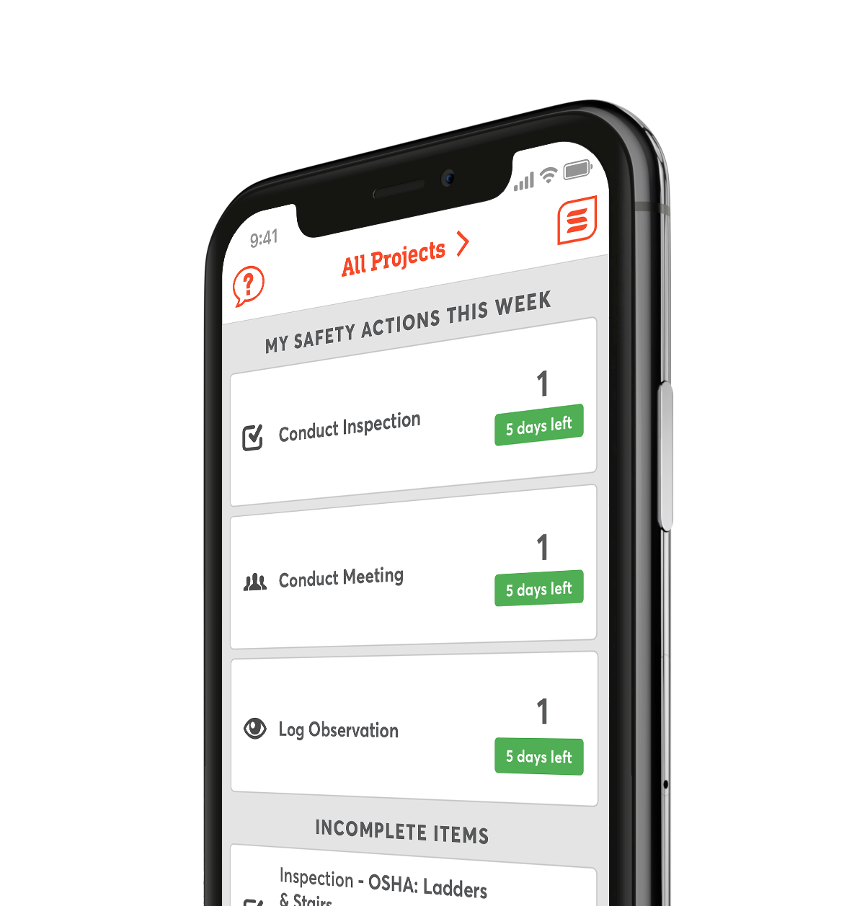
Digitize Your Safety Workflow
Safesite is a FREE, easy to use digital safety management tool.
Get started with safety inspections, audits, and checklists in seconds.

