Slide 1
Forklift Safety
January 2020
By Team Safesite

Slide 2
Forklift Risks
OSHA statistics show that an average of 100 employees are killed each year in forklift accidents, and as many as 95,000 total forklift accidents occur on an annual basis. In many cases, these accidents are avoidable.

Slide 3
In This Meeting
True Stories
Pedestrian Safety
Forklift Safety Signs
Operator Safety
The General Forklift Safety Meeting covers forklift safety basics. For more advanced training, see the Forklift Operator Safety Meeting.

Slide 4
True Stories: Forklift Fatalities
An individual was standing on a pallet on a forklift. The forklift operator was turning at a 90-degree angle while backing the forklift and lowering the pallet. The rider fell when the pallet was only 1-1/2 feet from the floor. He struck his head and died eleven days later from this injury.
A 43-year-old worker was standing by a flatbed in the process of covering materials with a tarp. A forklift operator was bringing twine to tie the load and approached the flatbed. The brakes failed and the victim was crushed between the forklift and the flatbed. He died about one hour later.
A forklift operator was lifting a load which exceeded the maximum for the forklift. When the forklift began to tip forward, the operator lowered the load and asked three employees to get on the back to act as a counterweight. When he lifted the load again, the forklift tipped forward, one individual fell striking his head in this fatal injury.
Photo Source

Slide 5
True Stories
What forklift incidents or near misses have you experienced?

Slide 6
NIOSH states that the 3 most common types of forklift injuries occur when a forklift overturns, workers are struck, crushed, or pinned by a forklift, and when workers fall from a forklift.

Slide 7
Pedestrian Safety: Basics
Pedestrians suffer 26% of all forklift-related injuries.
Be aware of forklift operation and pedestrian safety standards to protect yourself.

Slide 8
Pedestrian Safety: Basics
Don’t ride or stand on forklifts.
Be aware of your surroundings when forklifts are operating nearby.
Don’t engage in horseplay on or around forklifts.
Don’t walk or stand under forklift loads. Don’t allow a driver to pass a load over your head.
Photo Source

Slide 9
Pedestrian Safety: Basics
When standing in front of a wall, trailer, or other immovable object, don’t allow a forklift to approach you directly or put yourself between a forklift and its destination.
No smoking around battery charging areas.
Know and obey forklift safety signs.

Slide 10
Forklift Safety Signs
CAUTION, Look Out for Forklift Traffic, and pedestrian walkway markers are signs we use to alert you to forklift hazards.

Slide 11
Operator Safety
Only trained and authorized drivers are allowed to operate forklifts.
Our authorized drivers are:

Slide 12
Operator Safety
Even though authorized drivers are the only ones who should be driving, it’s still important to know forklift operator safety basics:
Don’t allow bystanders or coworkers to ride or stand on a forklift at any time.
Don’t engage in horseplay or reckless driving.
Do not pass the forks or loads over anyone's head or allow anyone to get beneath them.

Slide 13
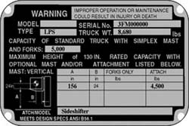
Operator Safety, Continued.
Don’t drive up to anyone standing in front of a fixed object of such a size that the person could be caught between the forklift and the object.
Conduct regular forklift maintenance according to company procedures.
Do not exceed the rated capacity shown on the forklift nameplate. (Don’t operate a lift if you cannot determine capacity.)

Slide 14
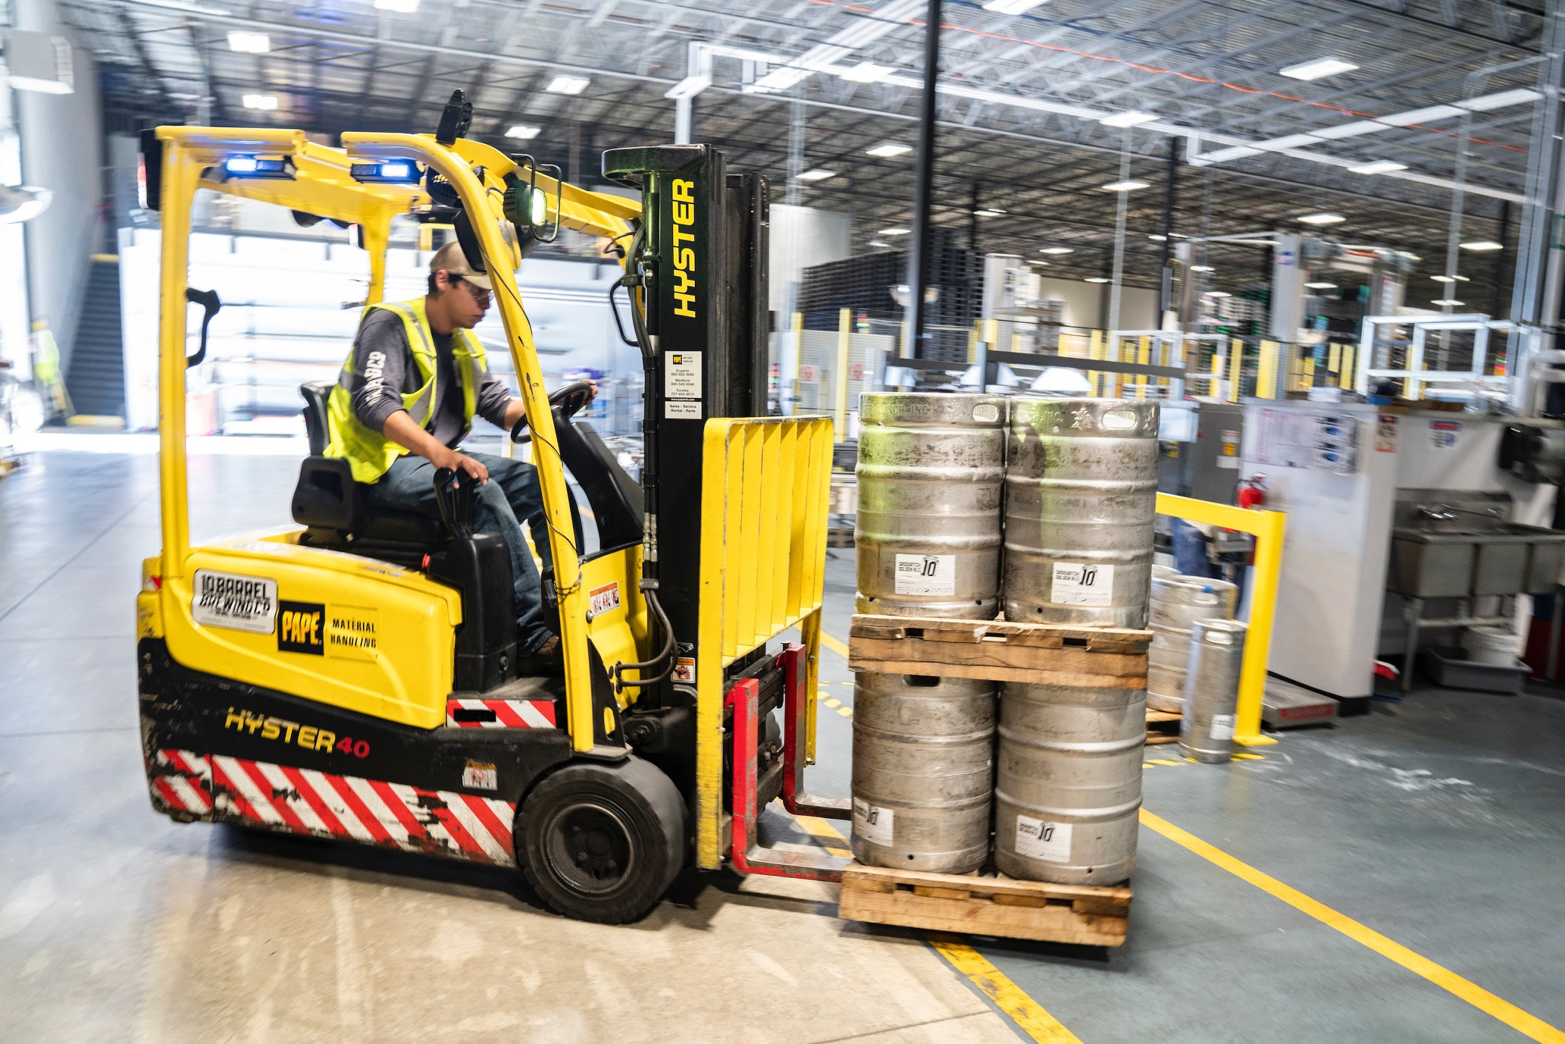
Operator Safety, Continued.
Always wear your seatbelt.
Do not move a loaded forklift until the load is safe and secure.

Slide 15
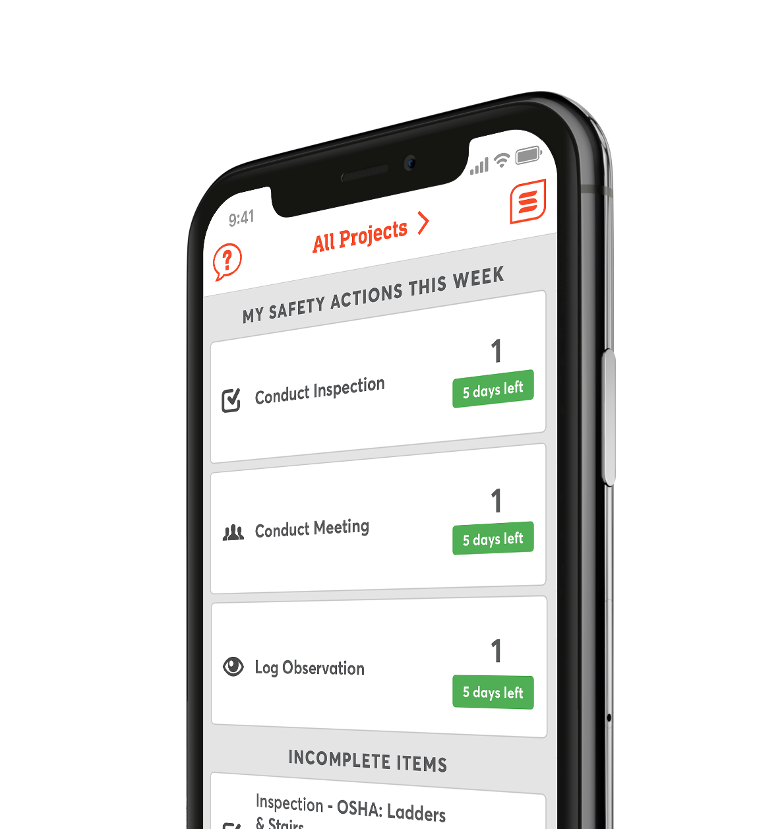
Digitize Your
Safety Workflow
Safesite is a FREE, easy to use digital safety management tool.
Get started with safety inspections, audits, and checklists in seconds.

