Slide 1
OSHA Slips, Trips and Falls
June 19, 2019
By Team Safesite

Slide 2
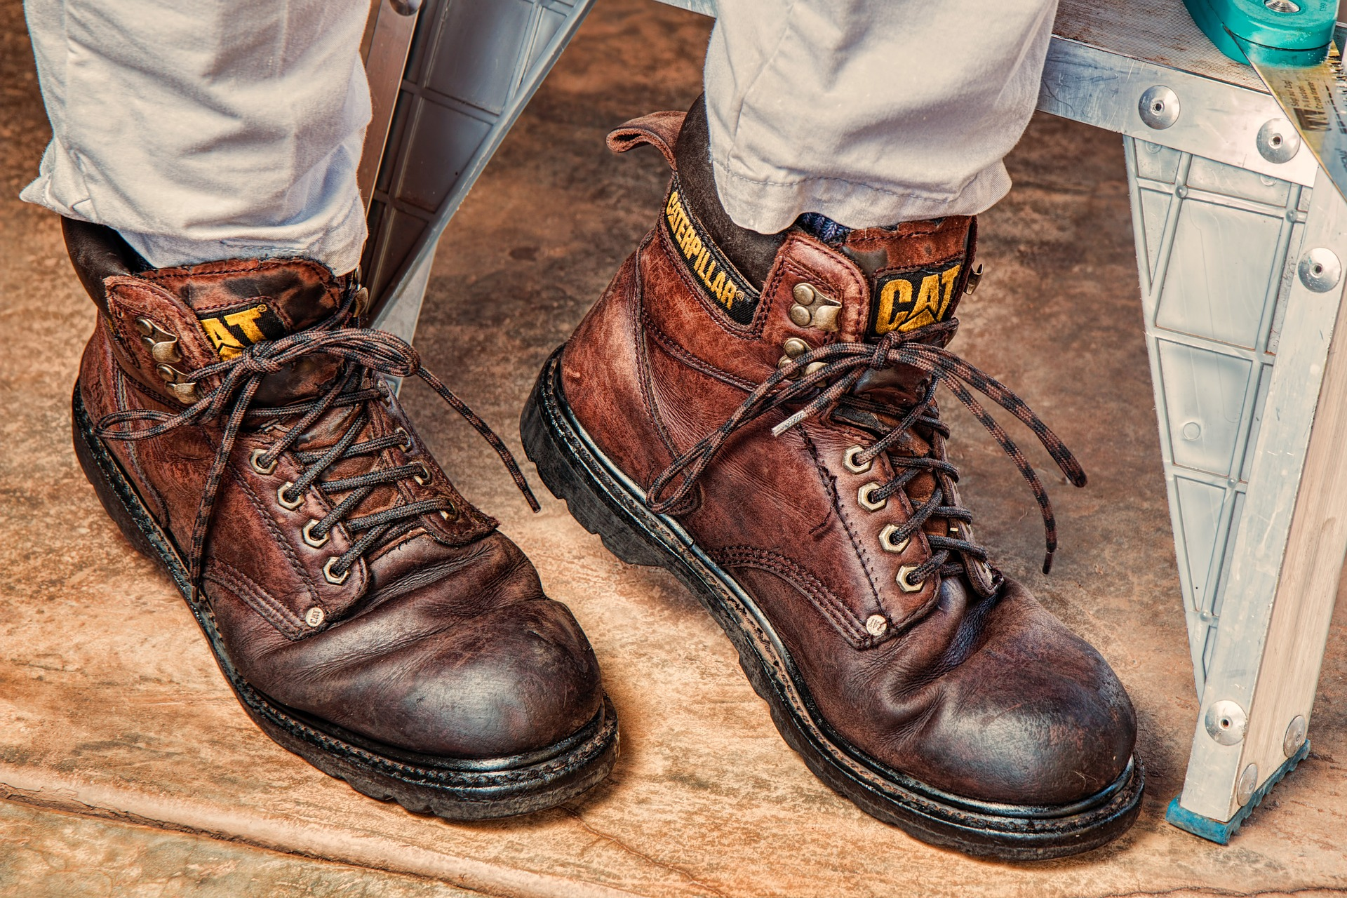
Quick Overview
According to OSHA, slips, trips and falls are among the most common causes of workplace injuries. This meeting covers walking/working surfaces and how to avoid these common injuries.

Slide 3
Falls
Falls are the second leading cause of accidental death.
Falls come in all sizes. From serious falls down a flight of stairs to small trips over the curled edge of a floor mat.

Slide 4
Any tripping accident can injure you. Falls are preventable.

Slide 5
Preventing Falls
Spot hazards in advance. They're easy to see if you pay attention. Keep aisles, walkways, and stairs clear. Good housekeeping is important. Clear away clutter.
Steer around hazards. Slow down, stay steady, and look carefully where you put your feet.
Alert Others: Repair or report the hazard.
Wear appropriate Footwear.
Photo Source

Slide 6
Spills and Slips:
Wet surfaces are one of the main causes of on-the-job falls.
To reduce slip hazards, clean up spills fast.
Take care around wet surfaces.
Slow down, keep a firm footing and maintain your balance.

Slide 7
More Safety Tips
Walking with caution is the number one way to prevent slips.
Walk slowly and carefully.
Use handrails on stairs.
Take one step at a time.
Do not carry large loads that you can't see around.
Make wide turns at corners, so you can have a view of what's ahead.

Slide 8
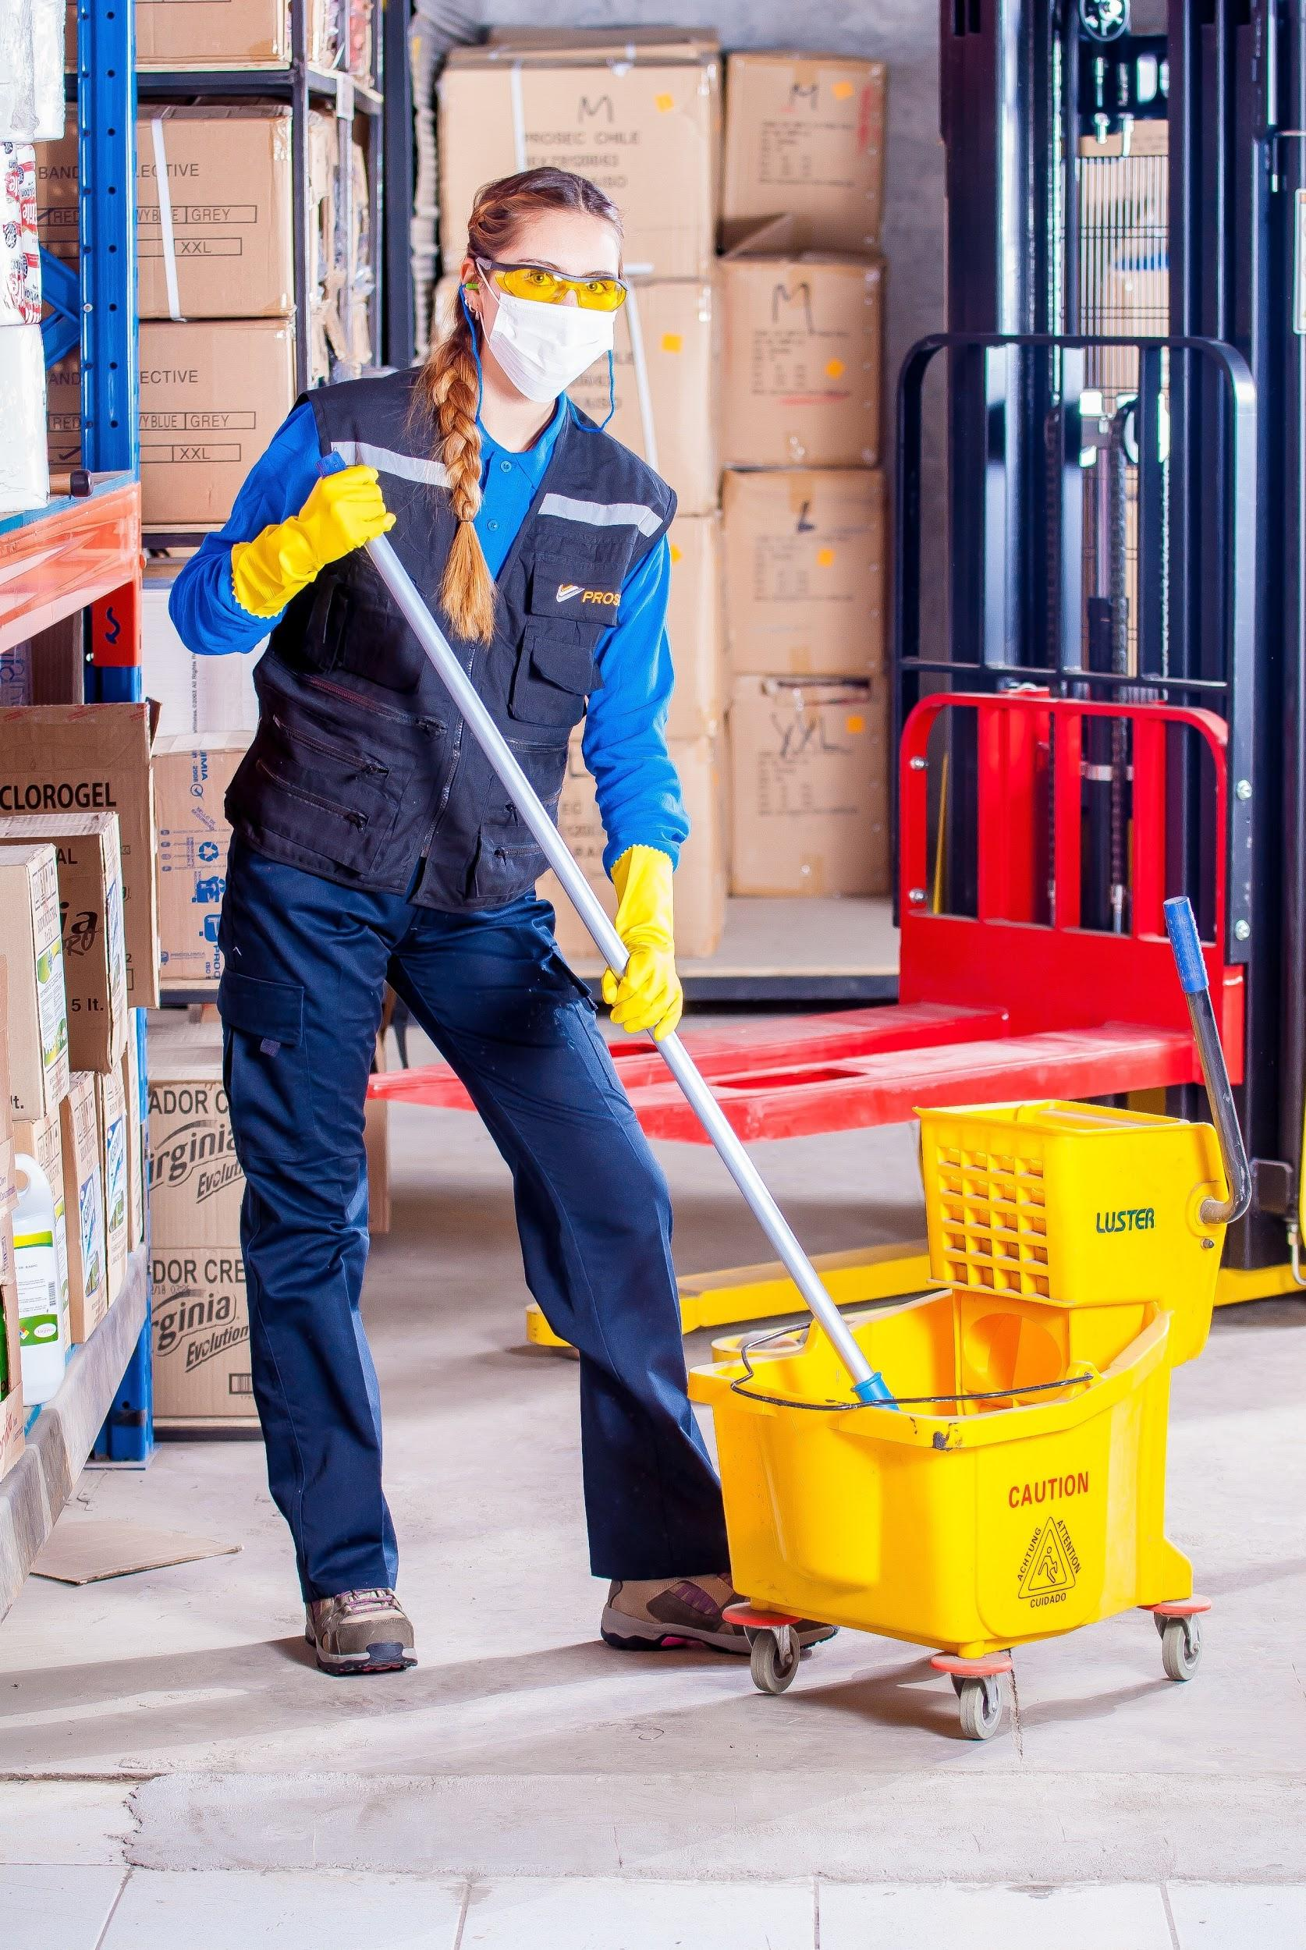
More Safety Tips, continued
7. Make sure your path is well lit.
8. Walking into a brightly lit room from the darkness can temporarily blind you. Slow down or stop until your eyes adjust so you can see where you are going.
9. Turn on the light before you enter the room. Never walk into a dark room.

Slide 9
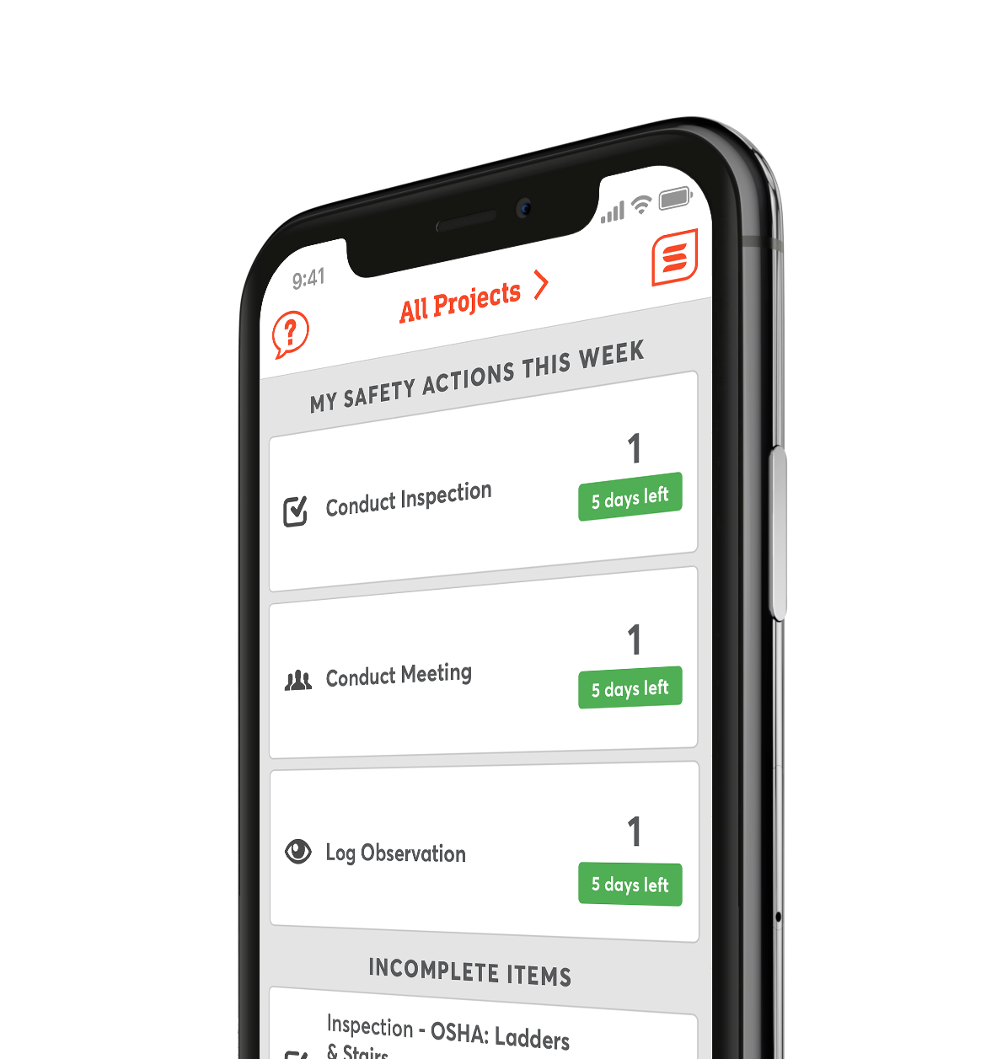
Digitize Your
Safety Workflow
Safesite is a FREE, easy to use digital safety management tool.
Get started with safety inspections, audits, and checklists in seconds.

