Slide 1
Safe Driving
Skills for Work
June 14, 2019
By Team Safesite

Slide 2
Quick Overview
Driving exposes you to a number of potential safety hazards. The more you drive, the higher your likelihood of experiencing a vehicle-related incident. Learn how to operate commercial or work vehicles safety and drive defensively to reduce your risk and stay safe.
Photo Source

Slide 3
Top Driving Hazards
Distracted driving caused by texting, mobile devices, eating, spills, etc.
Driving or other drivers under the influence of intoxicants
Driving while sleep deprived or very fatigued
Driving in dark, wet, or freezing conditions
Speeding or going too fast for conditions and/or terrain
Photo Source

Slide 4
What to do in a skid:
Prevent skids by driving slowly and carefully, especially on curves.
If you find yourself in a skid, remain calm, ease your foot off the gas and carefully steer in the direction you want the front of the car to go. If your car has anti-lock brakes, brake firmly as you “steer into the skid.” This procedure will bring the back end of your car in line with the front. (For cars without ABS, avoid using your brakes.)
Photo Source

Slide 5
Hydroplaning
Hydroplaning occurs when your tires lose contact with the road and ride on a layer of water; you lose control of your vehicle and are unable to maneuver.
To avoid this, keep your tires properly inflated, maintain good tread on your tires and replace them when necessary. Slow down when roads are wet and stay away from puddles. Try to drive in the tire tracks left by the cars in front of you.
If you find yourself hydroplaning, do not brake or turn suddenly; your car could skid. Ease your foot off the gas until the car slows and you can feel the road again. If you need to brake and your car has ABS, brake normally. If you do not have ABS, brake gently with light pumping actions.

Slide 6
Drive Defensively
Defensive drivers adjust their speed to wet road conditions in time to avoid driving in a skid or hydroplaning.

Slide 7
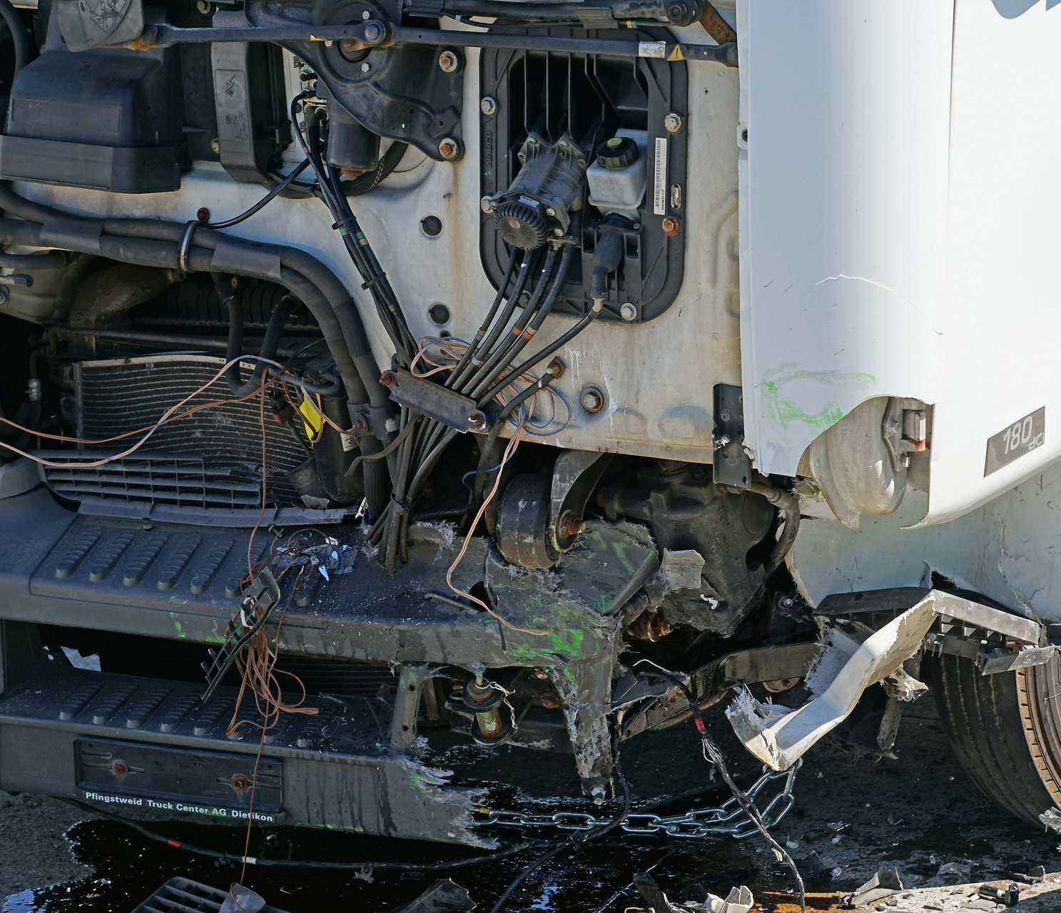
Alcohol Multiplies Risk
Alcohol is a leading factor in fatal traffic crashes, playing a part in about half of all motor vehicle-related deaths.
More fatal crashes take place on weekend nights than at any other time in the week.
Photo Source

Slide 8
Take Precautions While Driving at Night
Darkness – 90% of a driver’s reaction depends on vision, and vision is severely limited at night. Older drivers have even greater difficulties seeing at night. A 50-year-old driver may need twice as much light to see as well as a 30-year-old. If there is any doubt, turn your headlights on. Lights will not help you see better in twilight, but they’ll make it easier for other drivers to see you. Being seen is as important as seeing.
Fatigue – Drowsiness makes driving more difficult by dulling concentration and slowing reaction time. Signs of drowsiness include eyes closing or going out of focus, persistent yawning and inability to remember driving the last few miles. Get off the road and take a short nap in a well-lit area. Avoid driving between midnight and 6 am. Make frequent stops for light snacks and exercise.

Slide 9
Take Precautions While Driving at Night
3. Avoid collisions – It is more difficult to judge other vehicles’ speeds and distances at night.
Reduce your speed and increase your following distance to avoid collisions.
Photo Source

Slide 10
Safe Following Distance
During dry weather conditions, maintain a MINIMUM of 3 seconds of space between you and the vehicle in front of you. Do this by counting as you pass a fixed object such as a bridge, tree, or even a crack or shadow in the roadway.

Slide 11
Back Up Safely
Use a spotter.
Know your blind spots.
Perform a walk around.
Park defensively: pull through so you don't need to back out.

Slide 12
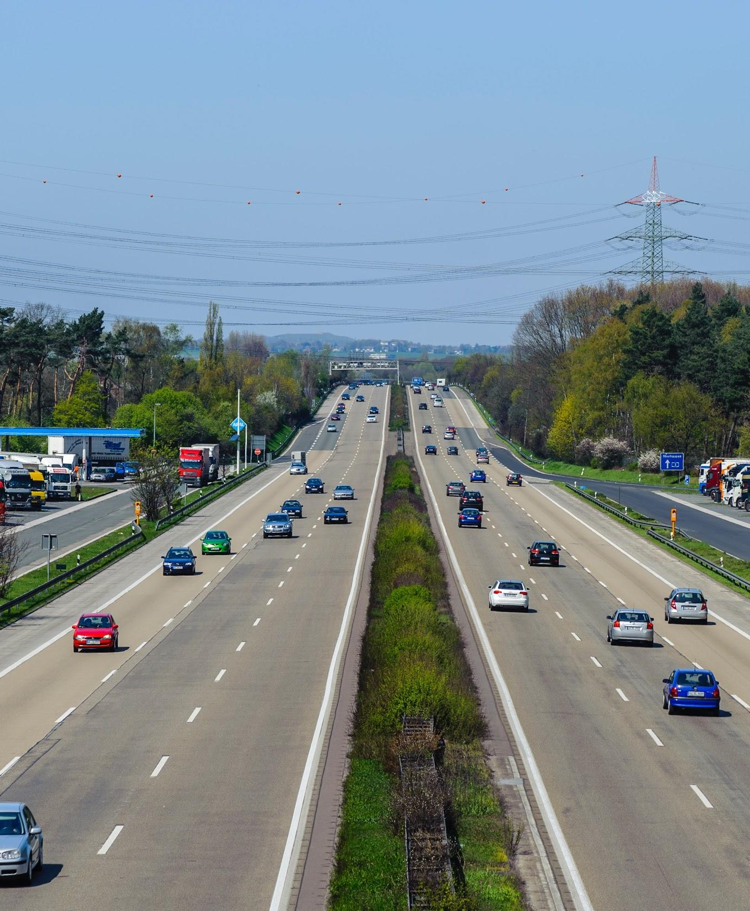
Defensive Driving Techniques
Minimize distractions.
Scan in front and around you.
Plan escape routes to avoid unsafe actions of other drivers.
Adjust your speed to the conditions.
Photo Source

Slide 13
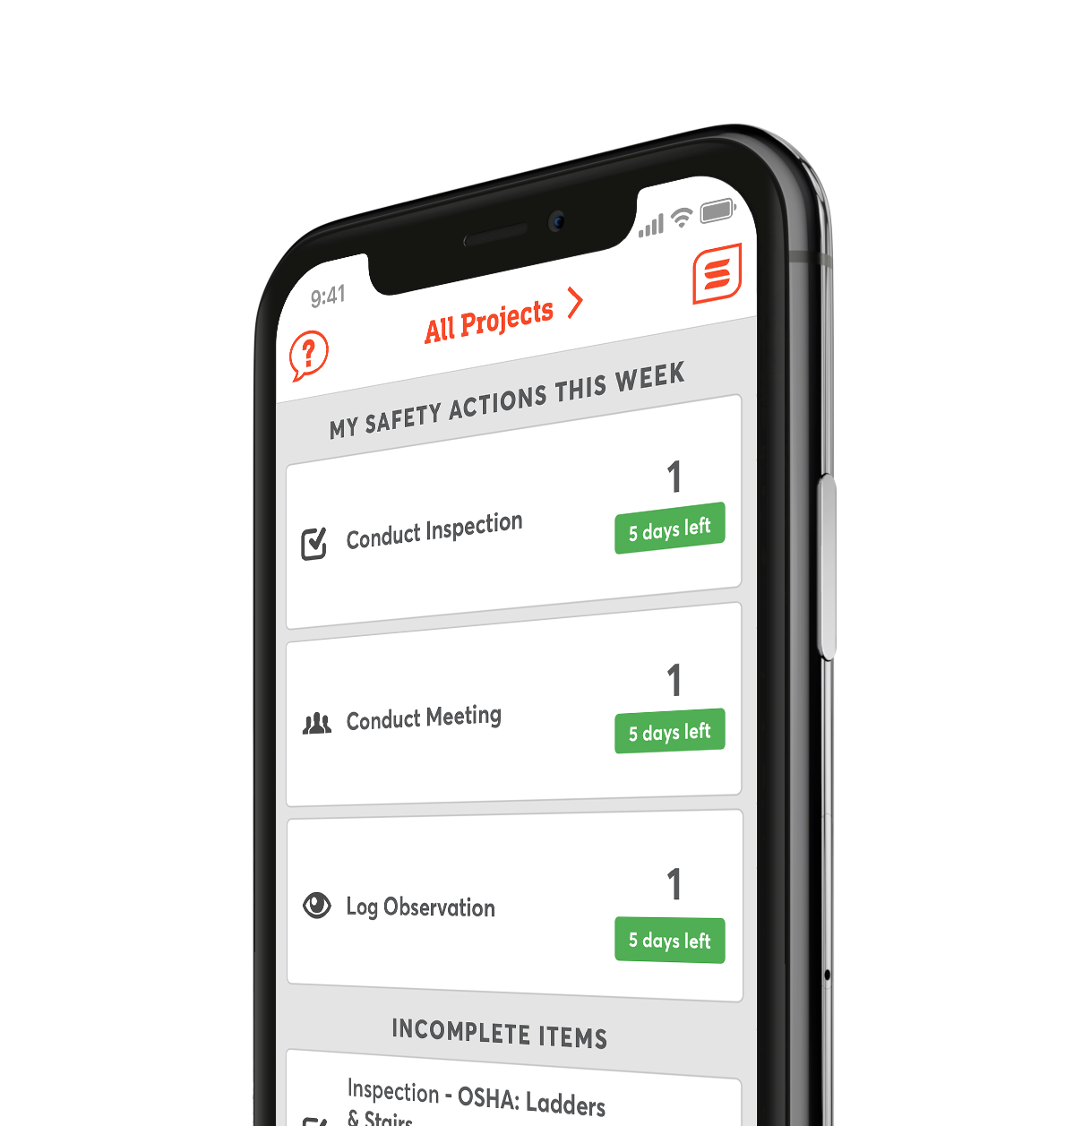
Digitize Your Safety Workflow
Safesite is a FREE, easy to use digital safety management tool.
Get started with safety inspections, audits, and checklists in seconds.

